Slide 1
Design Azure Web and Mobile Apps
Dave Burnison
Azure App Development
Dave.Burnison@Microsoft.com

Slide 2

Design Azure Web and Mobile Apps
Web Apps
API Apps
Mobile Apps
Push Notifications

Slide 3



Jason Haley
Jason Haley Consulting LLC
Salem, MA
@halejason
Independent Consultant
Azure & Angular
Microsoft Azure MVP
Microsoft Certified Solutions Expert: Cloud Platform and Infrastructure
Passed 70-532 (July 2016), 70-533 (Sept 2016), 70-534 (May 2017)

Slide 4
Exam 70-534 Architecting Microsoft Azure Solutions
#1 Design Azure Resource Manager (ARM) networking (5–10%)
Design Azure virtual networks - Extend on-premises
Describe Azure VPN and Express Route architecture and design
#2 Secure resources (20–25%)
Secure resources by using managed identities
Secure resources by using managed identities
Secure resources by using identity providers
Identify an appropriate data security solution
Design a role-based access control (RBAC) strategy
Manage security risks by using an appropriate security solution
#3 Design an application storage and data access strategy (5–10%)
Design data storage
Select the appropriate storage option
#4 Design advanced applications (20–25%)
Create compute-intensive applications
Create long-running applications
Integrate Azure services in a solution
Implement messaging applications
Implement applications for background processing
Design connectivity for hybrid applications
#5 Design Azure Web and Mobile Apps (5–10%)
Design Web Applications
Design Mobile Applications
#6 Design a management, monitoring, and business continuity strategy (20–25%)
Design a monitoring strategy
Describe Azure business continuity/disaster recovery (BC/DR) capabilities
Design a disaster recovery strategy
Design Azure Automation and PowerShell workflows
Describe the use cases for Azure Automation configuration
#7 Architect an Azure Compute infrastructure (10–15%)
Design ARM Virtual Machines (VMs)
Design ARM template deployment
Design for availability
+ Bonus: Containers
https://www.microsoft.com/learning/en-us/exam-70-534.aspx

Slide 5
#5 Design Azure Web and Mobile Apps (5–10%)
1. Design Web Applications
Design Azure App Service Web Apps, design custom web API, offload long-running applications using WebJobs, secure Web API using Azure AD, design Web Apps for scalability and performance, deploy Azure Web Apps to multiple regions for high availability, deploy Web Apps, create App Service plans, design Web Apps for business continuity, configure data replication patterns, update Azure Web Apps with minimal downtime, back up and restore data, design for disaster recovery
Design Mobile Applications
Design Azure Mobile Services; consume Mobile Apps from cross-platform clients; integrate offline sync capabilities into an application; extend Mobile Apps using custom code; implement Mobile Apps using Microsoft .NET or Node.js; secure Mobile Apps using Azure AD; implement push notification services in Mobile Apps; send push notifications to all subscribers, specific subscribers, or a segment of subscribers

Slide 6
Web Apps and Mobile Apps in 70-534
App Service
Web Apps
Mobile Apps
Web API Apps
Azure Functions
SQL Database
Notification Hub
Virtual Network (VPN)
Hybrid Connections
CDN
Traffic Manager
Security Options
Azure AD
External Identity Providers
Deployment
Scalability
High Availability
Disaster Recovery

Slide 7
There are many Azure products and features you need to be familiar with for the exam. In preparing for the exam, you should strive for at least an introductory level of understanding of Azure products that are not specifically called out in the exam skills. This will help you rule out choices when you see them on the exam.

Slide 8
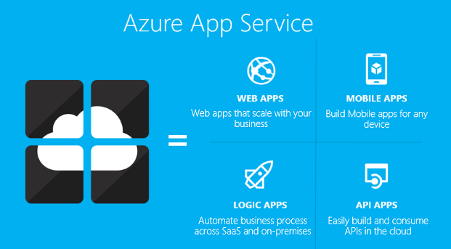
App Service
Authentication
Backup/Restore
Deployment
Networking
Scalability
WebJobs

Slide 9
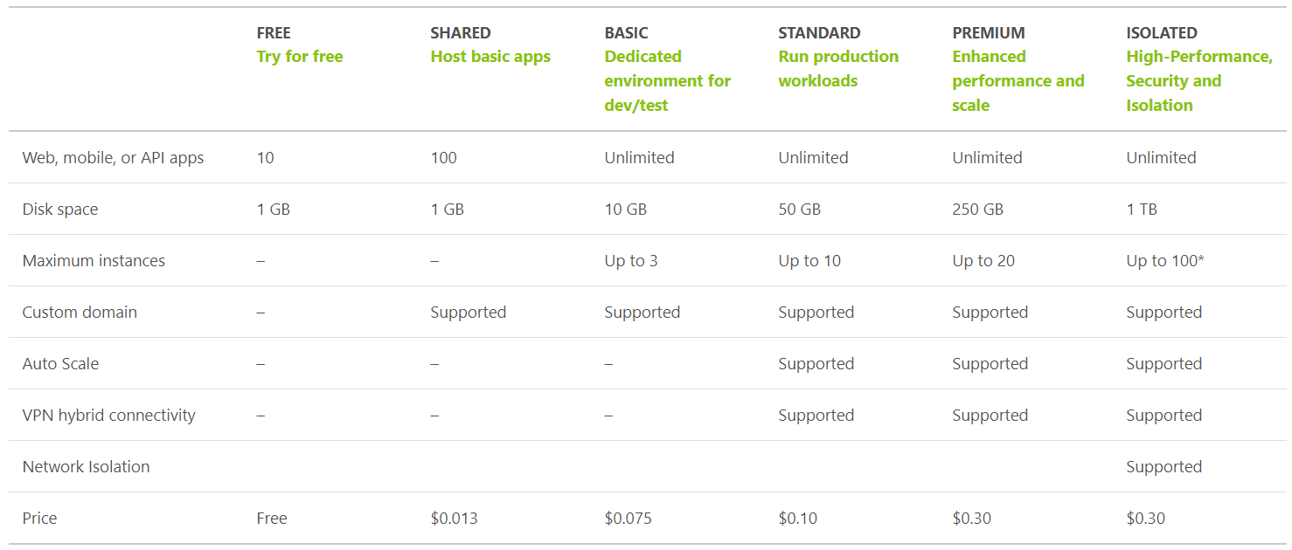
App Service Plan Tiers
https://azure.microsoft.com/en-us/pricing/details/app-service/plans/
Notes:
Prices are by the hour

Slide 10
App Service Plan
Represents the collection of physical resources used to host your apps
Region (West US, East US, etc.)
Scale count (one, two, three instances, etc.)
Instance size (Small, Medium, Large)
SKU (Free, Shared, Basic, Standard, Premium)
Web Apps, Mobile Apps, API Apps, Functions run in an App Service Plan
Notes:
Create App Service Plans
Azure App Service plans in-depth overview
https://docs.microsoft.com/en-us/azure/app-service/azure-web-sites-web-hosting-plans-in-depth-overview?toc=%2fazure%2fapp-service-web%2ftoc.json

Slide 11
You have an web app that is to be deployed in two data centers (east us and west us) and will use traffic manager, what is the least expensive service plan you can use?
Free
Shared
Basic
Standard
Premium
4) Standard

Slide 12
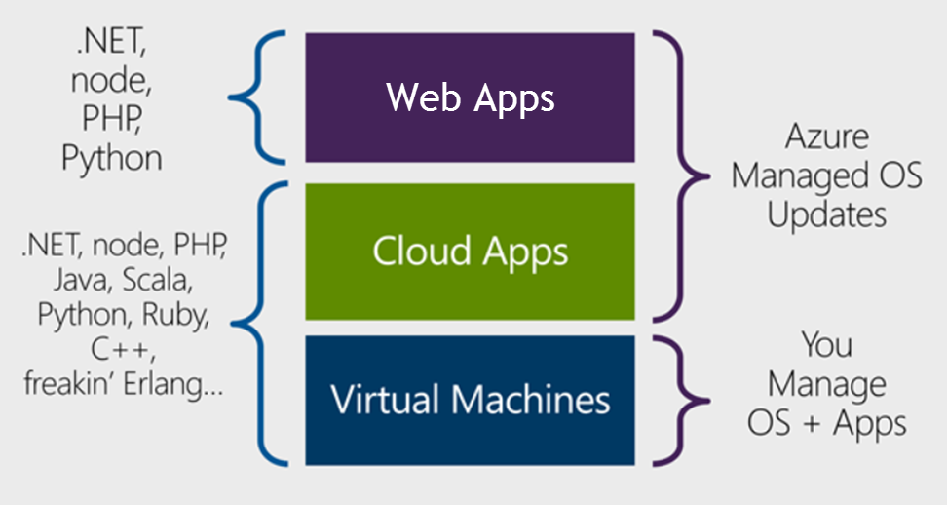
Design Azure App Service Web Apps
Notes:
Design Azure App Service Web Apps
Web Apps overview
https://docs.microsoft.com/en-us/azure/app-service-web/app-service-web-overview
https://docs.microsoft.com/en-us/azure/app-service-web/choose-web-site-cloud-service-vm#scenarios

Slide 13
Design Azure App Service Web Apps
Compute Options | Audience
App Service | Scalable Web Apps, Mobile Apps, API Apps, and Logic Apps for any device
Cloud Services | Highly available, scalable n-tier cloud apps with more control of the OS
Virtual Machines | Customized Windows and Linux VMs with complete control of the OS
Notes:
https://docs.microsoft.com/en-us/azure/cloud-services/cloud-services-choose-me

Slide 14
Design Azure App Service Web Apps
Platform as a Service (PaaS)
Azure Resource Manager (ARM) Technology
Easy to use with existing development skills:
VSTS/Git/GitHub/etc. for deployment Visual Studio integration
Other Azure options for deploying web applications:
Virtual Machines (IaaS)
Service Fabric (Microservice architectures)
Cloud Services (Web Roles and Worker Roles) – Older technology
Notes:
ASM = Azure Service Manager

Slide 15
When creating a website in Azure, which Azure services can you use?
Cloud Services
Virtual Machines
Web Apps
Microsoft Flow
Cloud Services
Virtual Machines
Web Apps

Slide 16
Quite a few Azure services provide the same capability. You need to understand the features and common usages in order to pick the best choices on the exam.
Example:
Virtual machines and web apps can be used for websites however you cannot remote desktop to a web app machine.
https://docs.microsoft.com/en-us/azure/architecture/guide/technology-choices/compute-comparison

Slide 17
Design Custom Web API
Web API is a one or more RESTful services (with one or more operations)
Endpoints expose services to external, partner or internal developers
Can implement in several technologies:
ASP.Net Web API
Node.js
App Service options:
Web App (if you need a web site too)
Mobile App
API App
Notes:
Design Custom Web API
Create a REST service using ASP.NET Web API and SQL Database in Azure App Service
https://docs.microsoft.com/en-us/azure/app-service-web/web-sites-dotnet-rest-service-aspnet-api-sql-database
https://azure.microsoft.com/en-us/services/api-management/

Slide 18
WebJobs
Flexible way to run background jobs
Runs on same resources as Web/Mobile/API app
Can be .cmd, .bat, .exe, .ps1, .sh, .php, .py, .js, .jar
Execution options:
Continuous (make sure App Settings has Always On enabled)
On Demand
Scheduled
Can scale with Web App or only run on single instance
WebJob SDK provides binding and triggering system
Notes:
Offload Long-Running Applications Using WebJobs
Deploy WebJobs using Visual Studio
https://docs.microsoft.com/en-us/azure/app-service-web/websites-dotnet-deploy-webjobs
Run Background tasks with WebJobs
https://docs.microsoft.com/en-us/azure/app-service-web/web-sites-create-web-jobs

Slide 19
What is the best option to add background processing to your web app?
Virtual Machines
Cloud Services
Worker Roles
Web Jobs
Network Security Groups
4) Web Jobs

Slide 20
Secure App Service – Azure AD
Azure AD B2B collaboration lets you enable access to your corporate applications from partner-managed identities. You can create cross-company relationships by inviting and authorizing users from partner companies to access your resources.
Azure Active Directory B2C is a highly available, global, identity management service for consumer-facing applications that scales to hundreds of millions of identities.

Slide 21
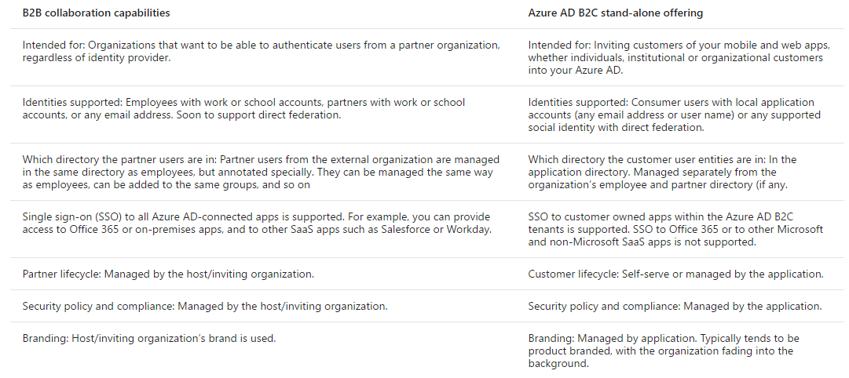
Azure AD B2B vs B2C
https://docs.microsoft.com/en-us/azure/active-directory/active-directory-b2b-compare-b2c

Slide 22
Secure App Service Options
On Premises AD
1. Connect and Sync with Azure AD
2. Authenticate through Azure AD
Azure AD B2B or B2C
Facebook
Google
Twitter
Microsoft Account
Notes:
Secure Web API using Azure AD
How to configure your App Service application to use Azure Active Directory login
https://docs.microsoft.com/en-us/azure/app-service-mobile/app-service-mobile-how-to-configure-active-directory-authentication
Secure an app in Azure App Service
https://docs.microsoft.com/en-us/azure/app-service-web/web-sites-security
Authentication and authorization in Azure App Service
https://docs.microsoft.com/en-us/azure/app-service/app-service-authentication-overview?toc=%2fazure%2fapp-service-mobile%2ftoc.json
Developing Web and Cross Platform Mobile Apps with Azure Active Directory
https://channel9.msdn.com/Events/Ignite/2015/BRK4850
Compare B2B collaboration and B2C in Azure Active Directory
https://docs.microsoft.com/en-us/azure/active-directory/active-directory-b2b-compare-b2c

Slide 23
You have a web app that needs to authenticate users against Active Directory but need to authenticate external users using social identity providers like Facebook and Twitter. Which services will you use?
Azure AD
Azure AD Domain Services
Twitter Bootstrap
App Service Authentication
Azure AD
4) App Service Authentication

Slide 24
Authentication and authorization is very important in real life and for this exam. App Service, Web Apps, Mobile Apps and API Apps can use the same App Service Authentication. You should plan time to explore and experiment with how to utilize these features.

Slide 25
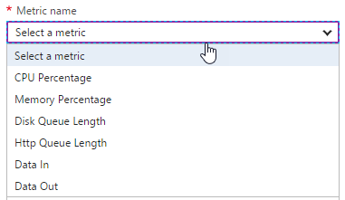
Design for Scalability and Performance
Scale Up – Change pricing tiers: Free, Shared, Basic, Standard, Premium
Scale Out – Change instance count: manually, auto
Scaling condition rules: Scheduled or Metric
Can have multiple condition rules
Can notify via email or webhook when autoscale events occur
Notes:
Design Web Apps for Scalability and Performance
Scale up an app in Azure
https://docs.microsoft.com/en-us/azure/app-service-web/web-sites-scale
Scale instance count manually or automatically
https://docs.microsoft.com/en-us/azure/monitoring-and-diagnostics/insights-how-to-scale?toc=%2fazure%2fapp-service-web%2ftoc.json

Slide 26
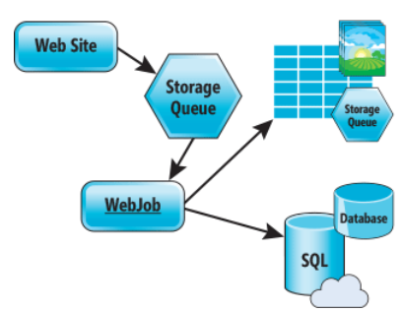
Design for Scalability and Performance
Design for Scale Out
Move towards stateless or at least distributed session/cache
Redis Cache for any Session/Cache needed
Move towards asynchronous UI
Queues for passing work off
Notes:
Azure Web Sites : Scaling Your Web Application with Azure Web Sites
https://msdn.microsoft.com/en-us/magazine/dn786914.aspx
Deploy Azure Web Apps to Multiple Regions for High Availability
Controlling Azure web app traffic with Azure Traffic Manager
https://docs.microsoft.com/en-us/azure/app-service-web/web-sites-traffic-manager
Add a Content Delivery Network (CDN) to an Azure App Service
https://docs.microsoft.com/en-us/azure/app-service-web/app-service-web-tutorial-content-delivery-network

Slide 27
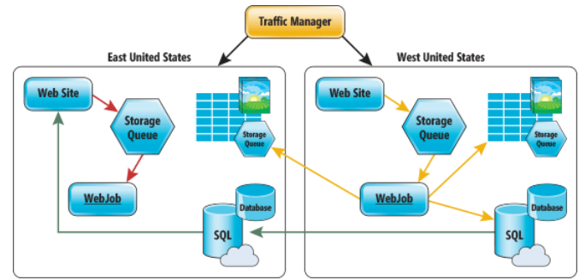
Deploy Azure Web Apps to Multiple Regions
Traffic Manager for routing traffic between regions
Performance – for directing user to closest region Failover – for secondary site Round Robin – for balancing traffic
CDN
Places static content close to user
Documents
Images
Media
etc.
Notes:
Deploy Azure Web Apps to Multiple Regions for High Availability
Controlling Azure web app traffic with Azure Traffic Manager
https://docs.microsoft.com/en-us/azure/app-service-web/web-sites-traffic-manager
Add a Content Delivery Network (CDN) to an Azure App Service
https://docs.microsoft.com/en-us/azure/app-service-web/app-service-web-tutorial-content-delivery-network
Best Practices: Windows Azure Websites (WAWS)
https://azure.microsoft.com/en-us/blog/best-practices-windows-azure-websites-waws/

Slide 28
You are going to deploy your web application on the east coast and west coast. You also want to make sure your users are sent to the closest location. What three things do you need to do?
Create a Traffic Manager profile
Set the Routing method to priority
Set the Routing method to performance
Create a new Resource Group
Add configure the endpoints in Traffic Manager
Create a Traffic Manager profile
Set the Routing method to performance
5) Add configure the endpoints in Traffic Manager

Slide 29
Deploy
Web Deploy
Kudu (Git/Mercurial/OneDrive/Dropbox)
VSTS/Github/Bitbucket
Browser drag and drop (Chrome and Firefox)
FTP/FTPS
Filezilla, Windows Explorer
App Service infrastructure can be setup using PowerShell, Azure CLI or RM templates
Notes:
Deploy Web Apps
Deploy your app to Azure App Service
https://docs.microsoft.com/en-us/azure/app-service-web/web-sites-deploy

Slide 30
Update Web Apps with Minimal Downtime
Deployment Slots are live apps with their own hostnames
Only available for Standard, Premium, IsolatedApp & Linux Service plans
Number of slots available depend on App Service Plan
App content and configurations can be swapped between two deployment slots
Not all settings and configurations are swapped
Some settings can be marked to not swap
Testing in Production feature allows you to spread traffic across multiple deployment slots
Notes:
Update Azure Web Apps with Minimal Downtime
Set up staging environments in Azure App Service
https://docs.microsoft.com/en-us/azure/app-service-web/web-sites-staged-publishing

Slide 31
What gets Swapped with a Deployment Slot?
Swapped | Not Swapped
App Settings – can be configured to not swap | Custom Domain Names
Connection Strings – can be configured to not swap | SSL certificates and bindings
General settings | Scale settings (only production slots are scalable)
Handler mappings | Publishing endpoints
Diagnostic logs settings

Slide 32
You have a Web App and want to create a staging deployment slot in order to test a release before moving to production. Your app service plan is currently a Shared plan. What two things do you need to do?
Call Microsoft support
Change your App Service Plan to a Basic plan
Create a new deployment slot named staging
Change your App Service Plan to a Standard plan
Create a new Resource Group
Create a new deployment slot named staging
Change your App Service Plan to a Standard plan

Slide 33
Design Web Apps for Business Continuity
Web/Mobile/API Apps
Multiple instances (single data center)
Multiple data centers with Traffic Manager to balance traffic
Backup/Restore
Notes:
Design Web Apps for Business Continuity
**Restore from Azure Backup Vault - SQL DB has to be set for long term retention
Built in HA for App Service, SQL Database and Storage
Business Continuity (BC) is defined as the capability of the organization to continue delivery of products or services at acceptable predefined levels following a disruptive incident. ( Source: ISO 22301:2012)
Controlling Azure web app traffic with Azure Traffic Manager
https://docs.microsoft.com/en-us/azure/app-service-web/web-sites-traffic-manager
Overview of business continuity with Azure SQL Database
https://docs.microsoft.com/en-us/azure/sql-database/sql-database-business-continuity
Designing resilient applications for Azure
https://docs.microsoft.com/en-us/azure/architecture/resiliency/

Slide 34
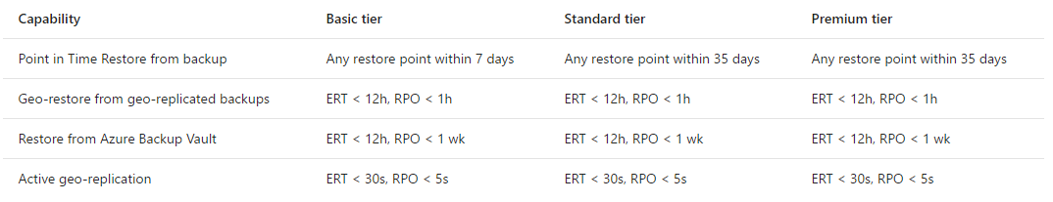
SQL Database features for Business Continuity
Recovery time objective (RTO) – maximum acceptable time before the application fully recovers after the disruption.
SQL Database
Point in time restore
Geo-restore
Restore from Azure Backup Vault
Active geo replication
Recovery point objective (RPO) – maximum amount of recent data updates (time interval) the application can tolerate losing.
Estimated recovery time (ERT) – estimated time interval needed to return service.

Slide 35
Configure Data Replication Patterns
Features Available
Blob storage: geo-redundant and read-access geo-redundant storage
SQL Database: geo-restore, geo-replicate
CosmosDB/DocumentDB: global replication
Custom Code
Can write WebJob to copy data to other regions or on-premise
Notes:
Configure Data Replication Patterns
Data Replication and Synchronization Guidance
https://msdn.microsoft.com/en-us/library/dn589787.aspx
Azure Storage replication
https://docs.microsoft.com/en-us/azure/storage/storage-redundancy

Slide 36
You have a Web App that uses SQL Database. You need to make sure your database will not be down any less than a one minute. Which option should you use?
Point in Time Restore
Active geo-replication
Azure Backup Vault
Site Recovery
StorSimple
2) Active geo-replication

Slide 37
Many Azure services are highly available (HA) by design – such as SQL Database, App Service, Azure Storage and CosmosDB. Others require you to use specific pricing tiers in order to get HA – such as Virtual Machines, Redis Cache and Search. Before taking the exam, you should look through the Service Level Agreements and learn what it takes to get HA for each product that is on the exam.
https://azure.microsoft.com/en-us/support/legal/sla/

Slide 38
Other great resources
https://docs.microsoft.com/en-us/azure/architecture/reference-architectures/ managed-web-app/scalable-web-app
https://docs.microsoft.com/en-us/azure/architecture/reference-architectures/ managed-web-app/multi-region-web-app

Slide 39
App Service Backup
Configure a storage account and container to store backup
Can store backup in another region
Configure schedule for backup to occur
Can optionally backup database also (as a bacpac file)
Exclude files with a _backup.filter file listing paths to exclude
Limit of 10GB of content for a backup (site files + bacpac)
Stores backup as .zip
Notes:
Back up and Restore Data
** For a database to appear in this list, its connection string must exist in the Connection strings section of the Application settings blade for your app.
Back up your app in Azure
https://docs.microsoft.com/en-us/azure/app-service-web/web-sites-backup
Restore an app in Azure
https://docs.microsoft.com/en-us/azure/app-service-web/web-sites-restore

Slide 40
App Service Restore
Restore options:
Replace existing app (backup was taken from)
Replace another app or create another app based on backup
Notes:
Back up and Restore Data
Restore an app in Azure
https://docs.microsoft.com/en-us/azure/app-service-web/web-sites-restore

Slide 41
Design for Disaster Recovery
Backup/Restore - is about data or workloads and getting them back to a known state and running.
Disaster Recovery - is about getting your systems up and running in another location.
Recovery time objective (RTO) – maximum acceptable time before the application fully recovers after the disruption.
Recovery point objective (RPO) – maximum amount of recent data updates (time interval) the application can tolerate losing.

Slide 42
Design for Disaster Recovery
How do you bring up a new site in a new location, if not using Traffic Manager?
1. Database Layer
Initiate unplanned failovers to bring secondary site up as primary
or perform geo-restore from replicated backup
2. Storage Layer
If only have read only access, need process to copy in order to read/write
3. Web Layer
Restore from backup (stored in storage account for failover site)
or Redeploy from RM templates and code from Releases repository
4. Fix up connection strings
Notes:
Mention the cloning option
Design for Disaster Recovery
Availability checklist
https://docs.microsoft.com/en-us/azure/architecture/checklist/availability
Best Practices: Windows Azure Websites (WAWS)
https://azure.microsoft.com/en-us/blog/best-practices-windows-azure-websites-waws/
Disaster recovery (DR) involves a set of policies and procedures to enable the recovery or continuation of vital technology infrastructure and systems following a natural or human-induced disaster.

Slide 43
You are evaluating your Web Apps for disaster recovery. What is the first thing you should look for?
Verify Backups are configured
Verify the SSL bindings
Check if Traffic Manager is setup
Confirm you are using Redis Cache
Verify Backups are configured

Slide 44
Take a look at the Azure PowerShell cmdlets and the CLI documentation. The exam will have questions that use either PowerShell or CLI commands.
Just because this is a design level exam, does not mean there won’t be any code level questions.

Slide 45
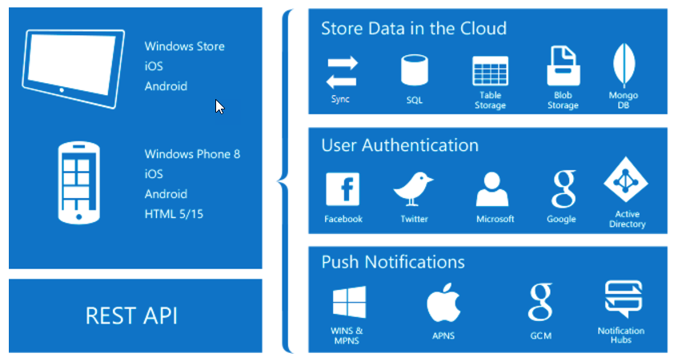
Design App Service Mobile Apps
Native and Cross Platform
Connect your enterprise
Build offline-ready apps
Scalable Push Notifications
Client SDKs:
iOS
Android
Windows
Xamarin
Cordova
Notes:
What is Mobile Apps?
https://docs.microsoft.com/en-us/azure/app-service-mobile/app-service-mobile-value-prop

Slide 46



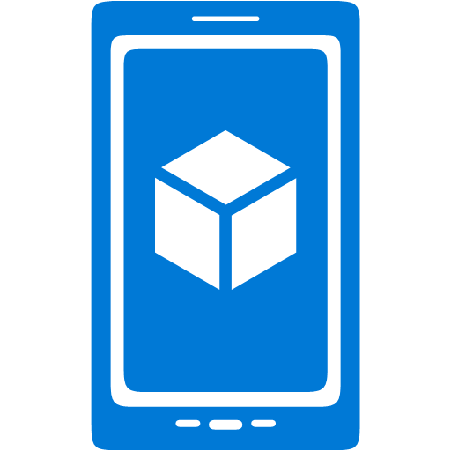




Offline Sync Capabilities
Mobile Client App – use platform specific SDKs and local data stores
SQL Lite or Core Data on iOS
Server endpoint – use SDK TableController base class for table syncing
Mobile Client App using SDKs
Mobile App/API App or Web App using SDKs
SQL Lite/Core Data
IMobileServiceSyncTable
TableController<T>
Notes:
Integrate Offline Sync Capabilities Into an Application
Offline Data Sync in Azure Mobile Apps
https://docs.microsoft.com/en-us/azure/app-service-mobile/app-service-mobile-offline-data-sync

Slide 47
Users of your mobile application need access to an on-premise database. Which of the following are valid steps for exposing that data?
Download and install the Hybrid Connection Manager
Add new hybrid connection
Configure Hybrid Connection Manager
Change connection string in web.config to point at new endpoint
Create Service Bus Relay
Download and install the Hybrid Connection Manager
Add new hybrid connection
Configure Hybrid Connection Manager

Slide 48
Extend Mobile Apps using Custom Code
Mobile Client SDKs available for:
Android
Apache Cordova
iOS
Windows
Xamarin.Android
Xamarin.Forms
Xamarin.iOS
Notes:
Extend Mobile Apps using Custom Code
Android
https://docs.microsoft.com/en-us/azure/app-service-mobile/app-service-mobile-android-how-to-use-client-library
Cordova
https://docs.microsoft.com/en-us/azure/app-service-mobile/app-service-mobile-cordova-how-to-use-client-library
iOS
https://docs.microsoft.com/en-us/azure/app-service-mobile/app-service-mobile-ios-how-to-use-client-library

Slide 49
Implement Mobile Apps Using Microsoft .NET or node.js
Mobile App server SDKs available for:
.NET
Node.js (has Easy Tables and Easy APIs available in portal)
SDKs provide:
Table operations for data access
Custom API operations
Push Notifications
Integration with Authentication
Notes:
Implement Mobile Apps Using Microsoft .NET or node.js
.NET
https://docs.microsoft.com/en-us/azure/app-service-mobile/app-service-mobile-dotnet-backend-how-to-use-server-sdk
Node.js
https://docs.microsoft.com/en-us/azure/app-service-mobile/app-service-mobile-node-backend-how-to-use-server-sdk

Slide 50
You have an existing Web App and want to add a Mobile App to the site. What do you need to do?
Create a new Web App
Create an Azure AD Application Proxy
Merge your Web App and Mobile App server code base
Create a Service Bus Namespace
3) Merge your Web App and Mobile Apps server code base

Slide 51
Secure Mobile Apps Using Azure AD
Mobile Client Apps use platform specific Azure Mobile Client SDKs
Server is same as App Service Authentication/Authorization
On Premises AD
1. Connect and Sync with Azure AD
2. Authenticate through Azure AD
Azure AD B2B or B2C
Facebook
Google
Twitter
Microsoft Account
Notes:
Secure Mobile Apps Using Azure AD
How to configure your App Service application to use Azure Active Directory login
https://docs.microsoft.com/en-us/azure/app-service-mobile/app-service-mobile-how-to-configure-active-directory-authentication
Authentication and Authorization in Azure Mobile Apps
https://docs.microsoft.com/en-us/azure/app-service-mobile/app-service-mobile-auth

Slide 52
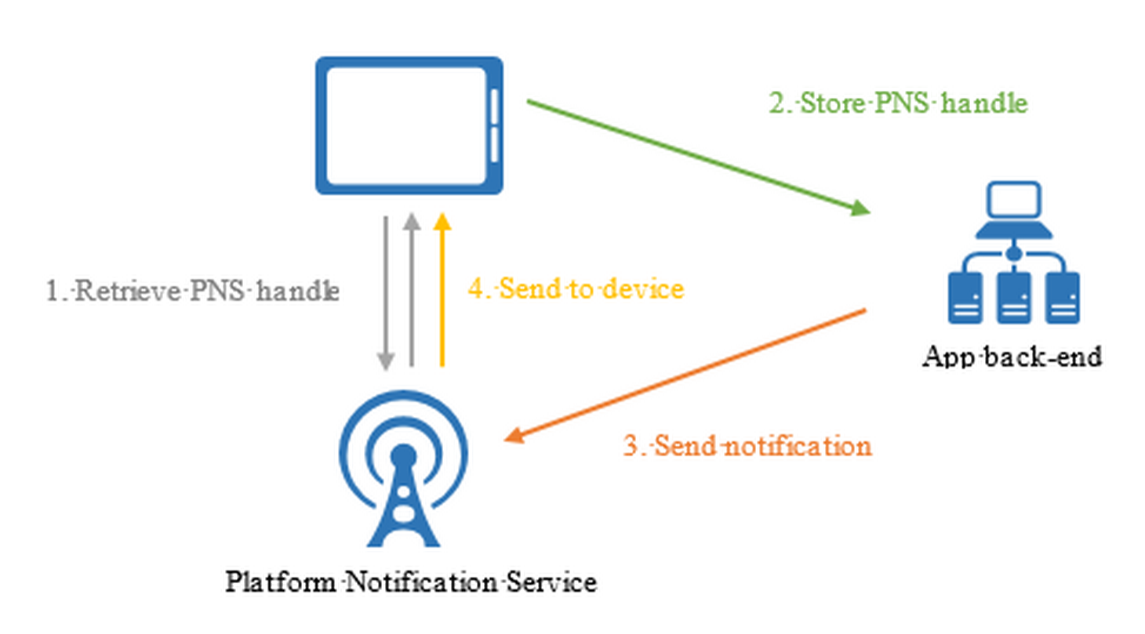
Implement Push Notification Services in Mobile Apps
Abstracts the choreography to support push notification to mobile clients
Apple Push Notifications (APNS)
Google Cloud Messaging (GCM)
Windows (WNS)
Windows Phone (MPNS)
Amazon (ADM)
Notes:
Implement Push Notification Services in Mobile Apps
Add push notifications to your Windows app
https://docs.microsoft.com/en-us/azure/app-service-mobile/app-service-mobile-windows-store-dotnet-get-started-push

Slide 53
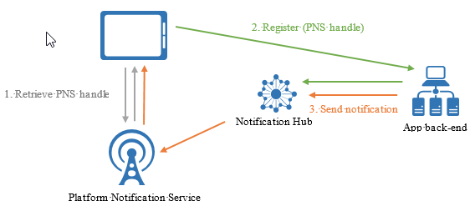
Send Push Notifications
Push on the App Service menu - Uses Notification Hubs
Broadcast to one or multiple platforms
Push to device or user
Push to segment with dynamic tags
Localized push
Silent push
Scheduled push
Direct push
Personalized push
Notes:
Send Push Notifications to All Subscribers
Send Push Notifications to Specific Subscribers
Send Push Notifications to a Segment of Subscribers
Azure Notification Hubs
https://docs.microsoft.com/en-us/azure/notification-hubs/notification-hubs-push-notification-overview

Slide 54
Mobile Apps are part of App Service, so the Authentication, Networking, Scaling, WebJobs, etc. are also available for Mobile Apps too.

Slide 55
Mobile Apps are mobile client apps and sever backend apps. Be prepared to answer questions on Node.js as well as .NET.
If you have never created a Node.js application, make sure you take the time and do the Mobile Apps tutorials that use Node.js for the backend.

Slide 56
Since there are multiple languages for the Mobile App SDKs, be familiar with the common objects and what they are used for. Both on the client sdk and server sdk.

Slide 57
Which of the following technologies can you build a Web API with?
Express
Restify
ASP.NET Web API
ADAL
Angular
Express
Restify
ASP.NET Web API

Slide 58
You have an on-premise ASP.NET MVC website that uses windows authentication. Which of the following items are steps you need to take in moving it to Azure?
Create an Azure AD
Create a SQL Database
Create and deploy as a Web App
Create a Redis Cache
Add application to Azure AD
Use the Authorize attribute
Connect and Sync local AD with Azure AD
Create an Azure AD
Create and deploy as a Web App
Add application to Azure AD
Use the Authorize Attribute
Connect and Sync local AD with Azure AD

Slide 59
You are concerned about the performance of a new Web App and want to make sure it scales when it starts to get heavy use. Which choice is the best for you to do?
Deploy another instance from Github
Change the Pricing tier to a larger machine size?
Configure auto scale to increase instance count when CPU hits 80%
Stop all WebJobs currently running on the WebApp
3) Configure auto scale to increase instance count when CPU hits 80%

Slide 60
You have a website that uses a lot of session state. You need to move the site to a web app in Azure. What two choices should you do?
Create a Virtual Machine
Create a Redis Cache
Download and configure the ASP.NET Session State Provider in your web.config
Deploy your web application to the virtual machine
2) Create a Redis Cache
3) Download and configure the ASP.NET Session State Provider in your web.config

Slide 61
You are having problems with stability of your latest website release. What can you do to minimize downtime?
Create multiple instances of your Web App
Change the App Service Plan to Premium
Setup VNET Integration
Create another deployment slot
Create multiple instances of your Web App

Slide 62
You are launching a beta site and have little budget to spend. You need to be ready in case the site or db goes down and are ok with some downtime. What is the best thing to do?
Deploy another Web App but don’t give anyone the URL
Setup Traffic Manager
Setup Backup for the Web App using a storage account in another region
Create a WebJob that backs up the database
3) Setup Backup for the Web App using a storage account in another region

Slide 63
You have a mobile app and need to allow your users to enter data while they are not online or connected to a network. What do you need to do?
Download your Windows Store certification
Change the native client app code
Expose a new endpoint on your server for data synchronization
Create a new Azure AD
Change the native client app code
Expose a new endpoint on your server for data synchronization

Slide 64
You have a Mobile App. Your managers want an alert on their mobile app about sales numbers at the end of day. How can you do that?
Set up an Alert for the App Service
Use Azure Scheduler to send the alert
Use a webhook
Use a Push Notification
4) Use a Push Notification

Slide 65
Your Mobile App needs to authenticate users from an on-premise Active Directory. What do you need to do?
Connect and Sync AD to Azure AD
Configure Mobile App to use Azure AD
Configure Vnet integration
Add a SSL binding
Connect and Sync AD to Azure AD
Configure Mobile App to use Azure AD

Slide 66
Labs
https://github.com/dstolts/70-534/tree/master/Labs

Slide 67
Mobile Solution Architectures
https://azure.microsoft.com/en-us/solutions/architecture/?solution=mobile

